Slide 1
Introduction to digital Audio Signals
EE6641 Analysis and Synthesis of Audio Signals
Prof. Yi-Wen Liu
Sep. 15, 2015

Slide 2
What is digital audio about?
Physical world
any transform (analysis)
and
processing (synthesis) you can think of
x(t)
D/A
x[n]
y[n]
A/D
y(t)
“sampling frequency”
“sampling frequency”
Notes:
Applications: (1) Effects (2) Coding

Slide 3
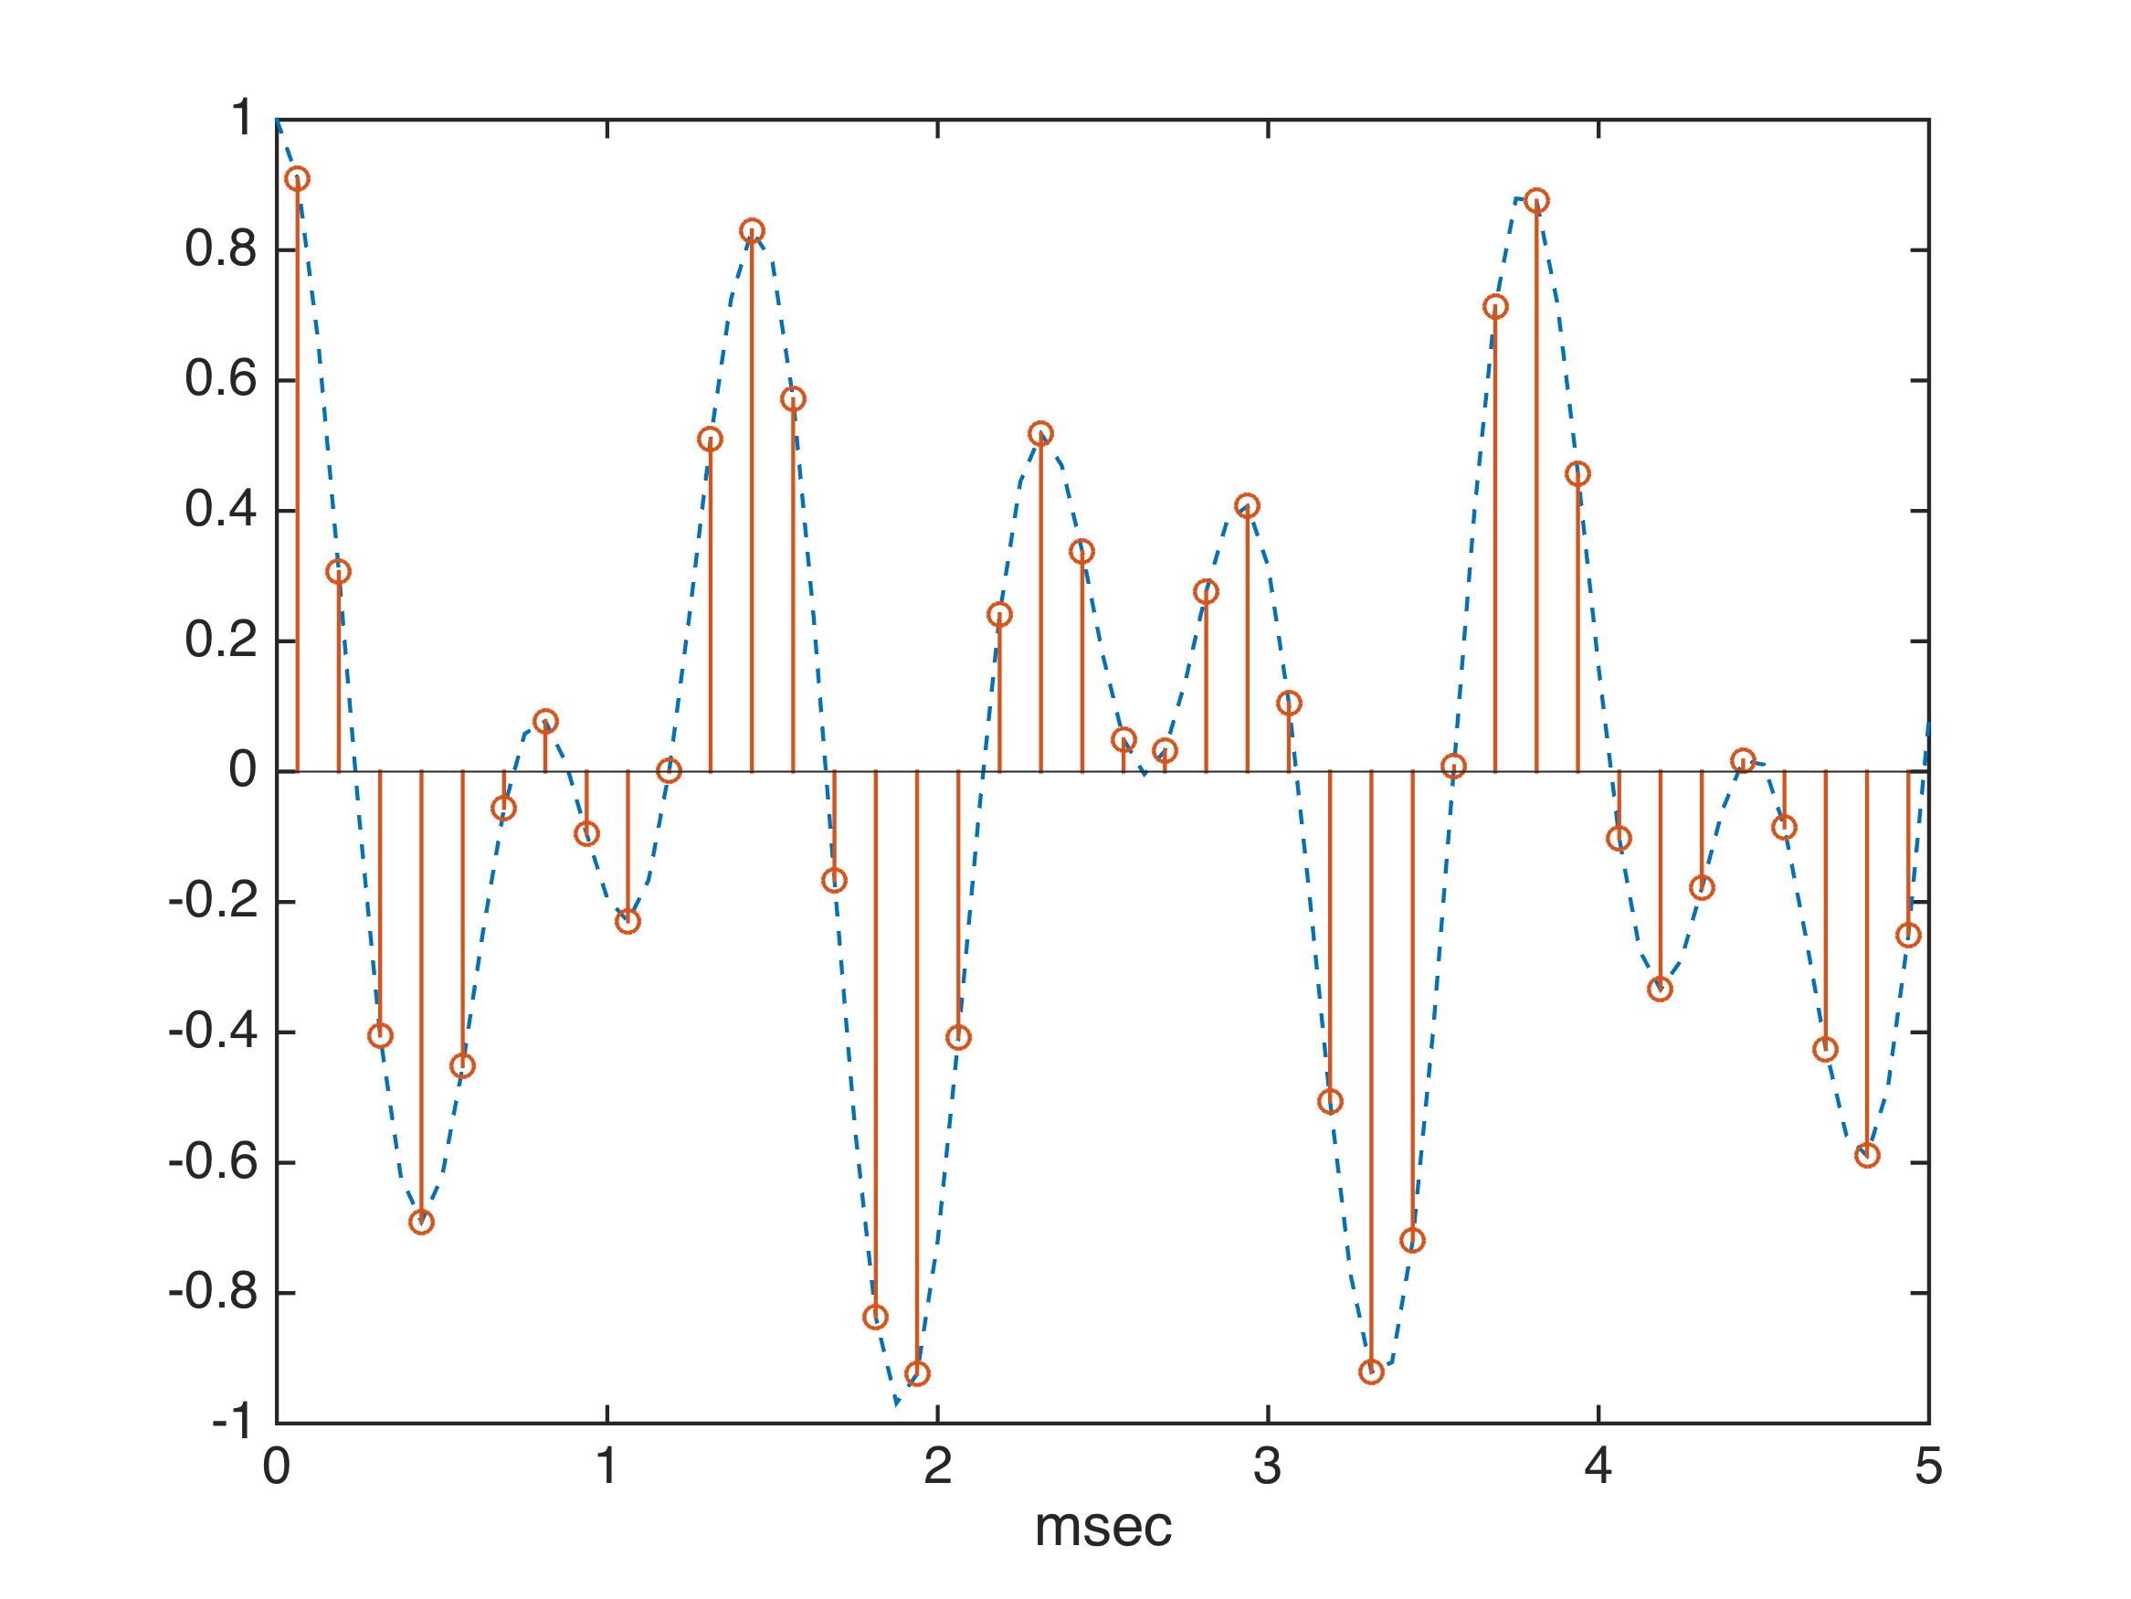
Sampling: To look at the waveform at discrete-time
Taken care by your soundcard with the “input”
Need to specify how often you want to sample
The unit of sampling rate = Hz.
Physical world
x(t)
D/A
x[n]
“sampling frequency”

Slide 4
Notes:
眯眯眼
40 samples in 1/200 sec. So sampling rate = ?
Conceptually, blue is continuous time. Red are its samples.
Question: How often do we need to sample?

Slide 5
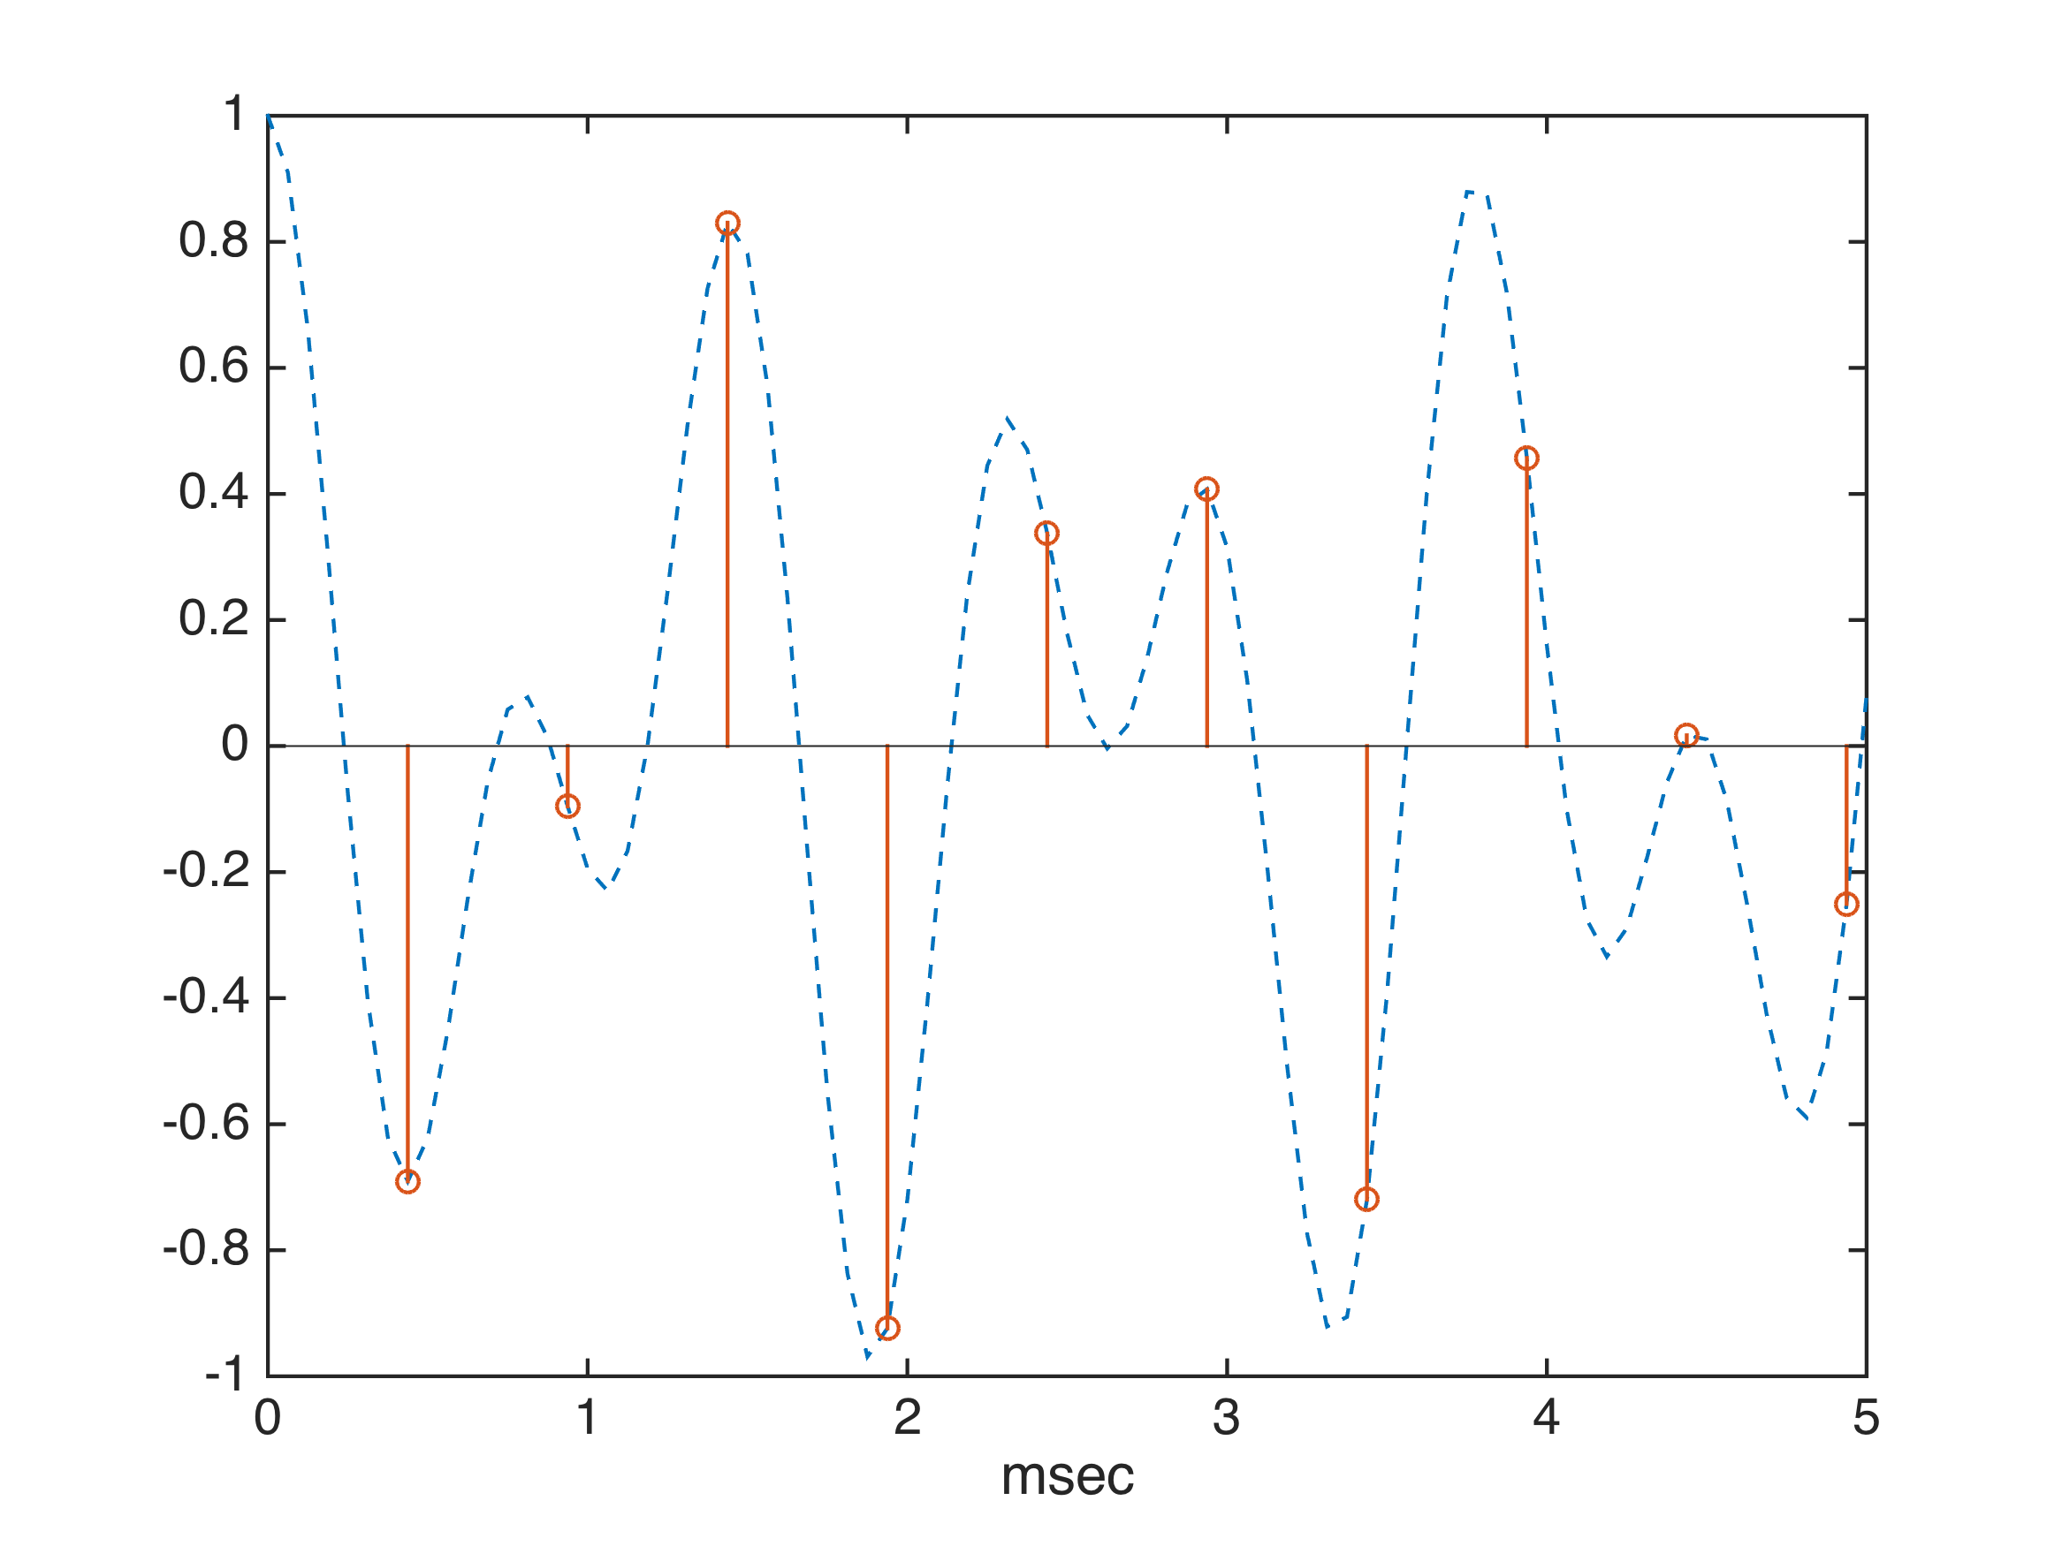
Undersampling

Slide 6
Nyquist theorem
Need to sample at least at 2x the rate of the highest frequency of interest.
E.g., f_{s} = 44.1 kHz for CD quality
Notes:
As compared to 8 kHz for land-line telephone.
What if not sufficiently sampled?

Slide 7
Quantization: fixed-point representation (usually)
Physical world
Physical world
Digital Domain
x(t)
D/A
x[n]
y[n]
A/D
y(t)
fs and nbits
fs and nbits
Nbits = 8, 16, 24, 32

Slide 8
Quantization step Δ
Below are directly printed from MATLAB’s document for wavwrite()
NBits y Data Type Data Range Output Format
8 single or double –1.0 <= y < +1.0 uint8
16 single or double –1.0 <= y < +1.0 int16
24 single or double –1.0 <= y < +1.0 int32
32 single or double –1.0 <= y <= +1.0 single
重點: Δ = 2 / 2^{Nbits}
Notes:
四捨五入解釋。
Q: Why 16 bits are sufficient for most applications?

Slide 9
Analysis without synthesis: Machine listening
Physical world
certain transform
x(t)
D/A
x[n]
x: feature
Machine Learning
Engines
“sampling frequency”
Training data (optional)
Notes:
Example: Speech recognition. 相關課程：Jeremy Lee

Slide 10
Digital Sound Synthesis
Controller
Algorithm
or
Models
y[n]
A/D
y(t)
Parameters
“sampling frequency”
Notes:
Example: Digital Instruments, 相關課程：交大聲創學程 黃志方教授，Max/MSP

Slide 11
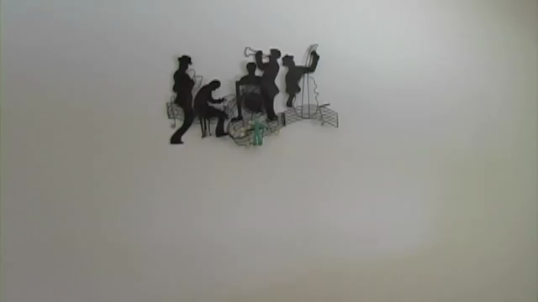
Demo of sound synthesis with a very specialized controller
Notes:
Can stop at near 2:20.

Slide 12
Related courses
李祈均教授：語音訊號處理
白明憲教授：聲學、陣列訊號處理
黃志方教授（交）：Max/MSP
冀泰石教授（交）：聽覺資訊處理

